Slide 1
Data Analytics Major Project and Placement MOD007894 Assessment Element - 011 Dissertation [10,000 words Eq]

Slide 2

Assessment Element – 011 Dissertation
This presentation outlines the necessary components that you must include in your Assessment Element – 011 (Dissertation).
Your Dissertation [Assessment Element 011] constitutes 90% of your total marks which makes it crucial for the success of this module.
Your Dissertation must be completed and submitted to the Canvas by the end of Tri3 week 13. Please have a close look at the Canvas assignments section for the exact submission deadline.

Slide 3

Assessment Element – 011 Dissertation
An academic member of staff will be assigned to you as your supervisor and she/he will supervise and guide you in preparation and academic conduct of your work.
You can mutually arrange periodical supervisory meetings. These meetings can be extremely crucial for the success in this module.
Remember, You are the Principle Investigator (PI) of your project and you are in charge of devising solutions, troubleshooting and write-up and not your supervisor.

Slide 4
Assessment Element – 011 Dissertation
You must strictly follow the provided template available in the Canvas for your dissertation.
Expected word count for your dissertation is 10,000 words with 10% leeway in both directions.
Your dissertation must be fully referenced and complied with academic research practices.
You must meticulously follow ARU’s referencing guidelines:
ARU Referencing Guide
Follow the instructions provided in the dissertation template carefully.

Slide 5
Assessment Element – 011 Dissertation
Dissertation Components:
Preamble:
Cover Page
Declaration Page
Acknowledgement Page
Table of Contents
List of Figures
List of Tables
List of Equations (if any)
Abstract

Slide 6
Assessment Element – 011 Dissertation
Cover Page
Data Analytics Major Project and Placement MOD007894
Assessment Element 011 – Dissertation
Project title
Word Count
module name and code
SID
Date

Slide 7
Assessment Element – 011 Dissertation
Cover Page
Project Title:
A maximum of 15 words that summarizes the main idea or ideas of your study.
A good title contains the fewest possible words that adequately describe the contents and/or purpose of your research paper.
Consult with your supervisor to word a proper title for your project.

Slide 8
Assessment Element – 011 Dissertation
Cover Page
Project Title:
The following parameters should be considered in formulating a suitable research title:
The purpose of the research
The narrative tone of the paper. [typically defined by the type of the research]
The methods used.

Slide 9
Assessment Element – 011 Dissertation
Cover Page
Project Title:
For every 10 readers who look at the title, one reads the Abstract; for every 10 who read the Abstract, one goes to the method and Results.
Contain as few words as possible; many journals limit title word count.
Be easy to understand.
Describe the contents of the paper accurately and specifically.
Avoid abbreviations, formulas, and jargon.
Avoid flashy literature and newspapers like scam titles.
Address the subject of the research rather than the results.

Slide 10
Assessment Element – 011 Dissertation
Declaration Page
At the front of the thesis submitted for assessment, students are required to incorporate a signed declaration. The declaration must state:
The thesis has been composed by the candidate.
The work has not been submitted for any other degree or professional qualification except as specified.
Any included publications are the student’s own work, except where indicated throughout the thesis

Slide 11
Assessment Element – 011 Dissertation
Declaration Page
Example:
I, John Doe, declare that the work in this dissertation titled “Design and development of a wonderful system using the extraordinary methods to improve everything” is carried out by me. This work has not been submitted to Anglia Ruskin University or any other educational institution for the award of a degree or educational qualification. I also declare that the information published in this dissertation has been obtained and presented in accordance with academic rules and ethical conduct. Any information obtained from other sources has been properly referenced.

Slide 12

Assessment Element – 011 Dissertation
Acknowledgement Page
A personal statement that expresses your gratitude to those who helped and supported you (family, friends, partners, funders, supervisor) for the fulfilment of this report and your studies.

Slide 13
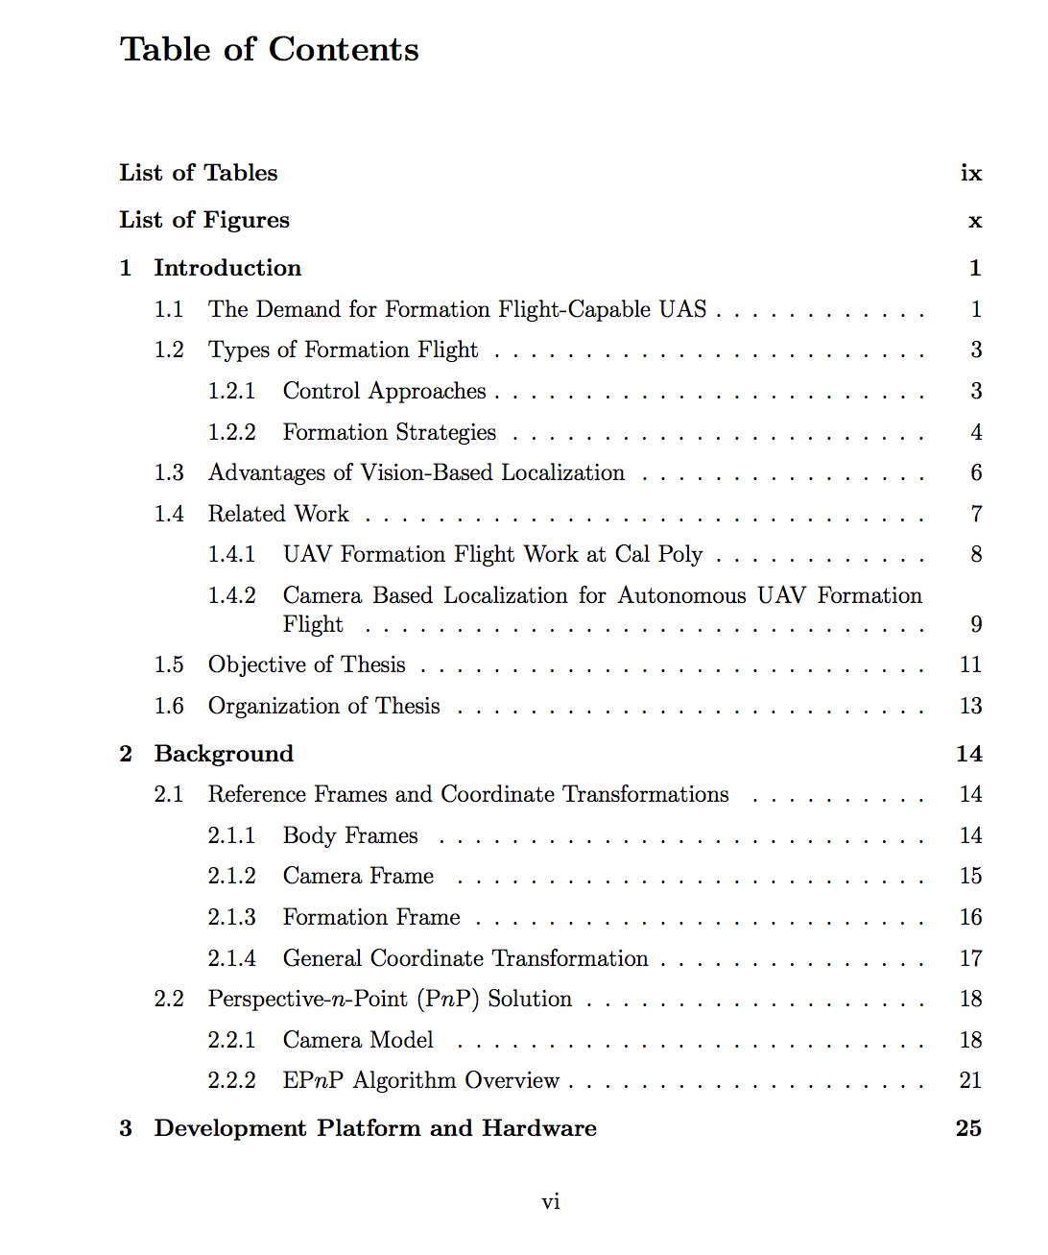
Assessment Element – 011 Dissertation
Table of Contents
Just an ordinary table of contents. Please ideally use Roman numbering for your manuscript preamble and Decimals for the rest of your document.

Slide 14
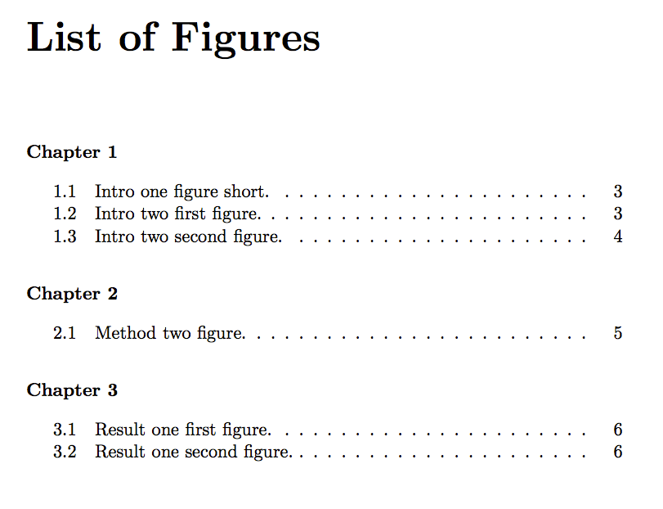
Assessment Element – 011 Dissertation
List of Figures
Figures number, caption and corresponding page number must be listed here.

Slide 15
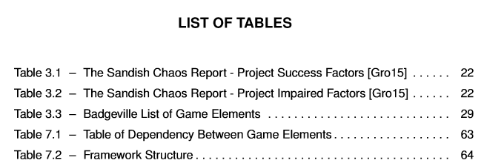
Assessment Element – 011 Dissertation
List of Tables
Table number, caption and corresponding page number must be listed here.

Slide 16
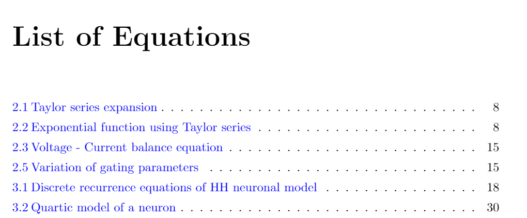
Assessment Element – 011 Dissertation
List of Equations (if any)
Equations number, caption, and corresponding page number must be listed here.

Slide 17
Assessment Element – 011 Dissertation
Abstract
The abstract is a summary of a complete work. It gives readers a chance to discover the key points of your dissertation, its research chapter, methodology and results part.
The abstract must be a single long paragraph (250 to 350 words). Citation is not required in the abstract.
Dedicate one full page to your abstract.

Slide 18
Assessment Element – 011 Dissertation
Abstract
Make sure your abstract exhibits the following sub-components and features:
250 to 350 words total
3 lines for context background info about the topic
3 lines for talking about the research gap which is the motivation of your study.
5 lines for explaining the research method and contribution.
2 lines for explaining the major findings.
2 line for a conclusive statement (research impact and implication)

Slide 19
Assessment Element – 011 Dissertation
Dissertation Main Body
Chapter 1: Introduction
Your dissertation’s introduction chapter needs to provide an overview of your planned research, as well as a clear rationale for it.
In other words, this chapter has to explain the “what” and the “why” of your research – what’s it all about and why’s that important.

Slide 20
Assessment Element – 011 Dissertation
Dissertation Main Body
Chapter 1: Introduction
1.1 Overview
1.2 Problem Background
1.3 Research Aim
1.4 Research Objectives
1.5 Research Significance*
1.6 Research Scope
1.7 Research Limitations*
1.8 Methodology
1.9 Contribution
* Optional

Slide 21
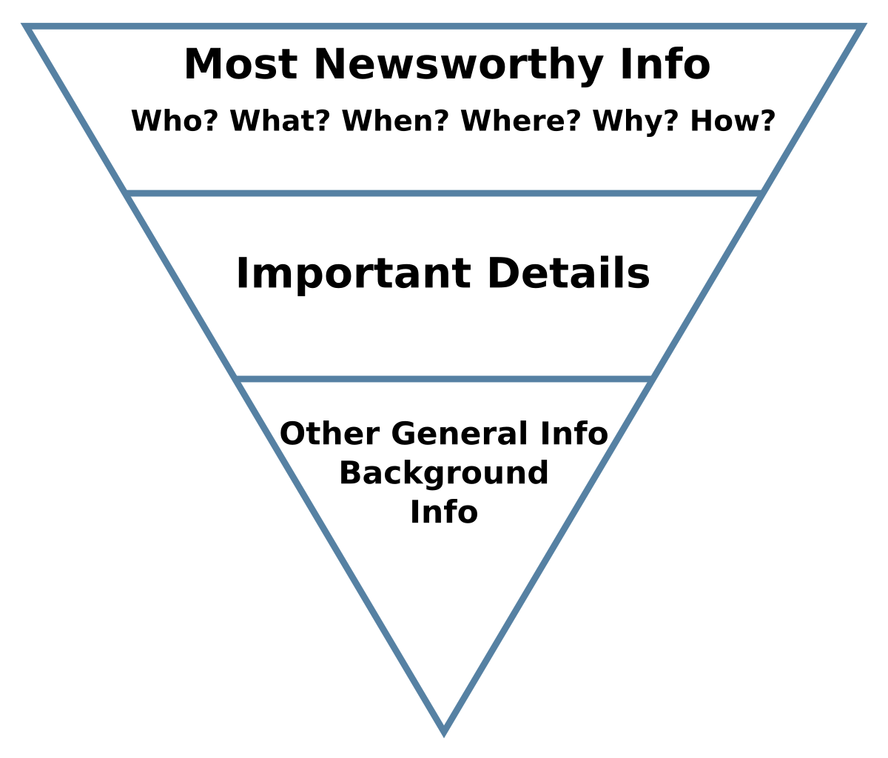
Assessment Element – 011 Dissertation
1.1 Overview
Recommended length is around 2 pages.
Describes context and background information surrounding the placement to help readers understand the basics and context.
Do use an inverted pyramid structure to elaborate your arguments meaning placing the most fundamental information in the lead paragraphs of your story, and then arranging the remaining details, from most important to least important, in the following paragraphs.
This section must be cited and referenced.

Slide 22
Assessment Element – 011 Dissertation
1.2 Problem Background
Elaborate on the issues that are surrounding the state of affairs of your chosen topic/project.
Identify what is wrong or can be done better with the regard to the chosen topic and how it impacts the placement provider workflow.
Talk about the main gaps/shortcomings in the literature (current state of the operations) which derives your research motivations.
Then, propose a tentative rough solution (short paragraph – 3 lines ) to these shortcomings. this is your research hypothesis.

Slide 23
Assessment Element – 011 Dissertation
1.2 Problem Background
Identify issues that are surrounding your topic
Identify shortcomings of the existing solutions
(Research gap)
Propose a solution
(research hypothesis)

Slide 24

Assessment Element – 011 Dissertation
1.3 Research Aim
Outlines your overall research goal.
Recommended length is around 1 to 2 paragraphs.
Think of the aim as an extended research title.
It must explain what is going to be achieved? and how it is going to be achieved.

Slide 25
Assessment Element – 011 Dissertation
1.4 Research Objectives
Objectives are self-contained, self-sufficient milestones that collectively contribute toward the fulfilment of your research goal.
Describe your objectives through bullet point statements. you should define 2 to 4 objectives for your research.

Slide 26
Assessment Element – 011 Dissertation
1.4 Research Objectives
Examples:
Objective 1: To investigate possible adverse impacts of lossy compression algorithms on BLE audio transmission measured by SNR metric.
Objective 2: To design and develop a working prototype of a lossless compression algorithm capable of working with available BLE bandwidth.

Slide 27

Assessment Element – 011 Dissertation
1.5 Research Scope
Consists of 2 implicit sub-sections including in-scope and out-of-the-scope.
In scope outlines the inner boundary of your work. Parameters that you are considering to measure and monitor. Factors and aspects of the topic that you are caring and considering to cover in your research.
Out of the scope outlines parameters, aspects and issues that are not the concern of your research and won’t be investigated. Think of it as a disclaimer clause.

Slide 28
Assessment Element – 011 Dissertation
1.6 Methodology
This sub-section is essentially a miniature version of the third chapter of your dissertation, The methodology.
Here you should summarize your Chapter 3 (Research Methodology) into 2 to 3 paragraphs.

Slide 29
Assessment Element – 011 Dissertation
1.7 Contribution
Outline the final products/findings of your research that contributes toward the fulfilment of the research gap (stated in section 1.2) in a holistic and high-level narrative.
Talk about your overall research impact and how it contributes to the state of affairs of your chosen topic expressed in section 1.2.

Slide 30

Assessment Element – 011 Dissertation
Chapter 2 (Literature Review)
What have been done so far by others.
A literature review is a survey of scholarly knowledge on a topic. It is used to identify trends, debates, and gaps in the research.
The literature review chapter is an overview of the key literature that's relevant to your research topic.
Standing on the Shoulders of Giants

Slide 31
Assessment Element – 011 Dissertation
2.1 Overview
Describes context and background information about the topic and restate the research gap to help readers understand the basics and current state of the literature, topic and existing solutions.
Think of it as an icebreaker section for the main body of your literature review.

Slide 32
Assessment Element – 011 Dissertation
2.2 Custom sub-heading that represents the main topic
For example, if your research is about Handwriting Recognition your 2.2 subheading can be “Handwriting Recognition”.
Start this section with a taxonomical study.
Investigate and elaborate this section in a hierarchical order.
Start with the main general topic and then dig into details including explaining different approaches, techniques, aspects/perspectives, etc.

Slide 33
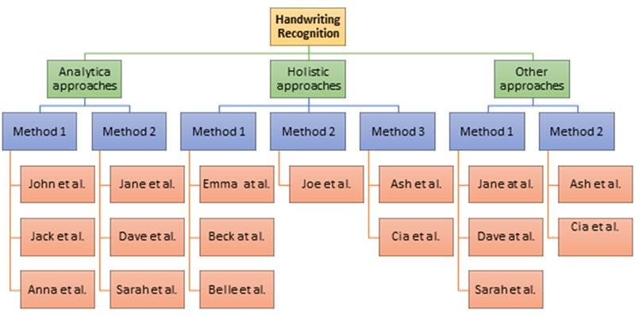
Assessment Element – 011 Dissertation
2.2 Custom sub-heading that represents the main topic
Design a hierarchical taxonomy diagram (as below) and explain each branch and their sub-branches and their corresponding scientific works.
Provide pros/cons, and critical analysis for each branch and each study.

Slide 34
Assessment Element – 011 Dissertation
2.2 Custom sub-heading that represents the main topic
Remember, chapter 2 is NOT about you and your work and your idea.
It is about the works of others and existing solutions so do not talk about your employed method in this chapter at all but try to form your narrative to make room for your work and your idea.

Slide 35
Assessment Element – 011 Dissertation
Chapter 3 (Research Methodology)
Your methodology chapter is where you highlight the philosophical underpinnings of your research and outline the specific research design choices you’ve made.
The point of the methodology chapter is to tell the reader exactly how you designed your research and to justify your design choices.

Slide 36
Assessment Element – 011 Dissertation
3.1 Overview
Restate the research problem situation and your corresponding proposed solution concept in a holistic and high-level narrative.
Think of this section as an icebreaker for chapter 3.

Slide 37
Assessment Element – 011 Dissertation
3.2 Research Framework
Create a technical data pipeline using block diagram that outlines the consecutive steps (processes) that needed to be taken to get the research aim and objectives delivered, or the artefact developed.
Explain each step (process) in detail.
Describe the operations in consecutive chronological order.
Provide enough detail that renders your work reproducible.

Slide 38
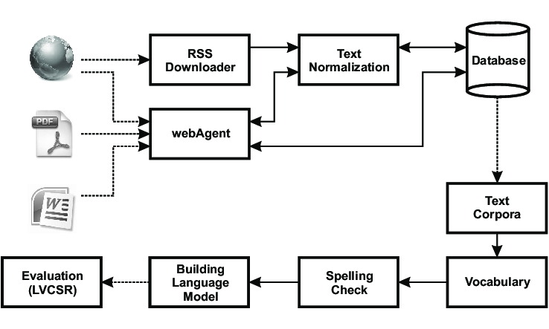
Assessment Element – 011 Dissertation
3.2 Research Framework
Block Diagram

Slide 39
Assessment Element – 011 Dissertation
3.3 Data Collection / Structure
For studies with primary data collection [questionnaire, interview, observation], explain your data collection method.
For empirical studies that mainly rely on secondary data, explain your dataset Structure, the statistical moments, sample types, histogram, missing values, data types, distribution. training, evaluation, and testing sets.

Slide 40
Assessment Element – 011 Dissertation
3.4 Evaluation Metrics
Explain your success/evaluation/measurement criteria.
What factors/metrics will be measured and how they will be measured?
Metrics like Accuracy, False positive, false negative, true positive, sensitivity, loss, confusion matrix, specificity, F-Score, etc.
Note: do not exhibit your results here. Just explain what metrics will be used to measure the proposed model performance.

Slide 41
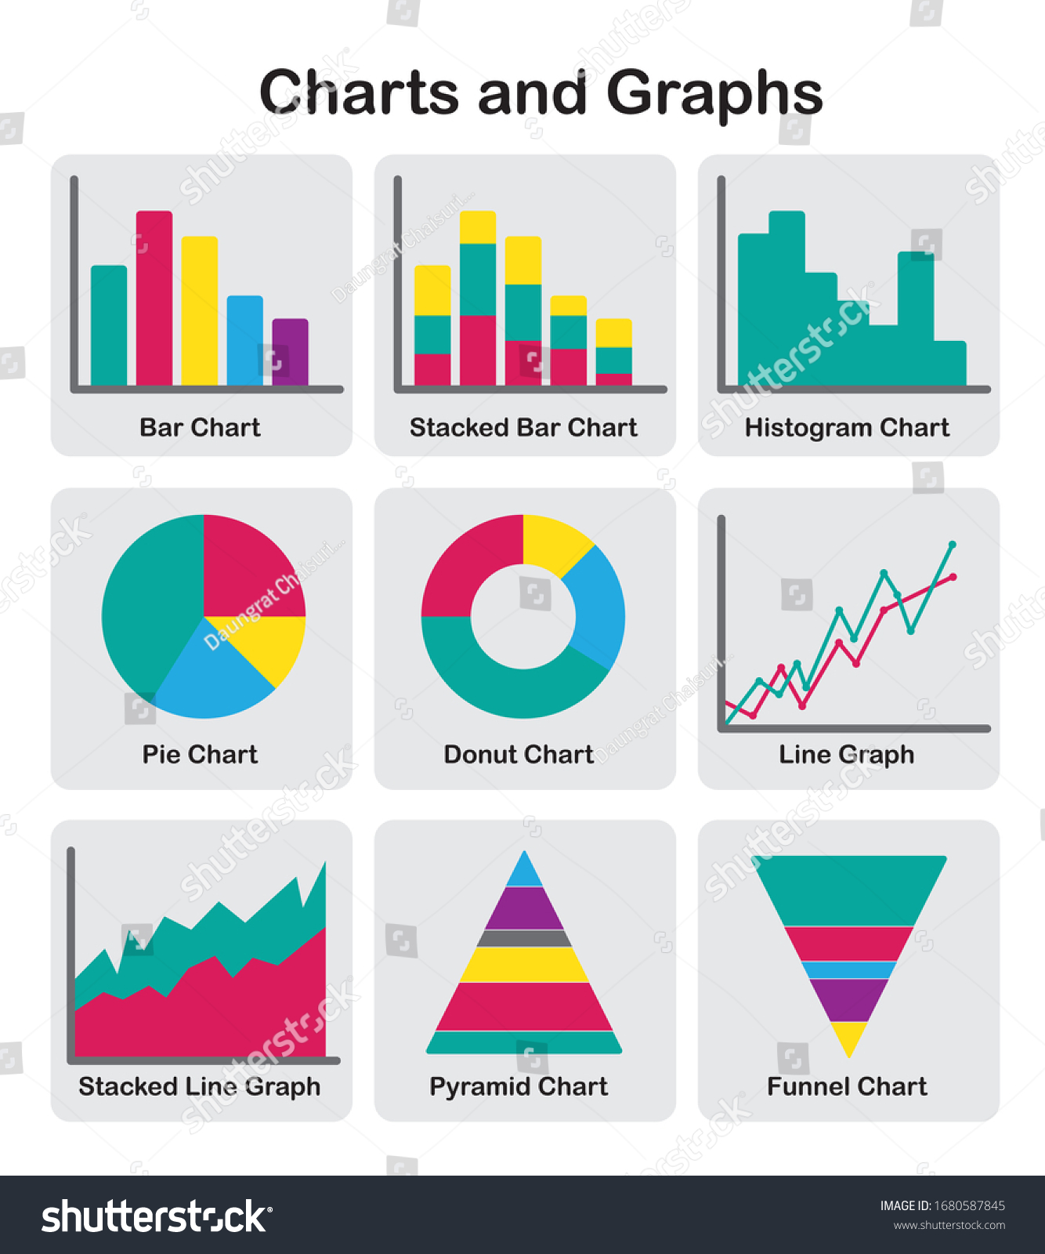
Assessment Element – 011 Dissertation
Chapter 4 (Results)
This Chapter is where you present your research results.
Categories your finding into sub-sections based on their natures and where they contribute and research questions they answer.
Use tables and charts (bar charts, pie charts, histograms, scatter plots) generously.

Slide 42
Assessment Element – 011 Dissertation
Chapter 4 (Results)
Interpret your charts and results. Explain trends, behaviors, and statistical moments.
This chapter is all about figures and numbers and charts.
Leave high-level/holistic explanations/Interpretations for the discussion chapter.

Slide 43
Assessment Element – 011 Dissertation
Chapter 5 (Discussion)
Categories your discussion into sub-chapters based on their natures and where they contribute and research questions they answer.
Follow the same structure as your results chapter.
Move away/step back [Zoom-out] from the numbers/figures and explain what those numbers mean in a more general and holistic scene and how they contribute toward the fulfilment of the research gap.
Interpret your findings using high-level explanations.

Slide 44
Assessment Element – 011 Dissertation
Chapter 6 (Conclusion)
Restate the gap, and research goal answer the research question based on your research findings and appraise work.
Criticize your work in the form of future work.

Slide 45
Assessment Element – 011 Dissertation
References
Use Harvard-ARU format:
https://library.aru.ac.uk/referencing/files/QuickHarvardGuide2019.pdf
Minimize the use of web articles and white papers as these sources are NOT peer-reviewed.
More than 70% of your references should be sourced from peer-reviewed studies and articles (use google scholar and other scientific repositories [IEEE, science direct, scopus ] to search for these articles).
Use recent (last 5 to 7 years) studies mainly.

Slide 46
Thank You!

